Slide 1

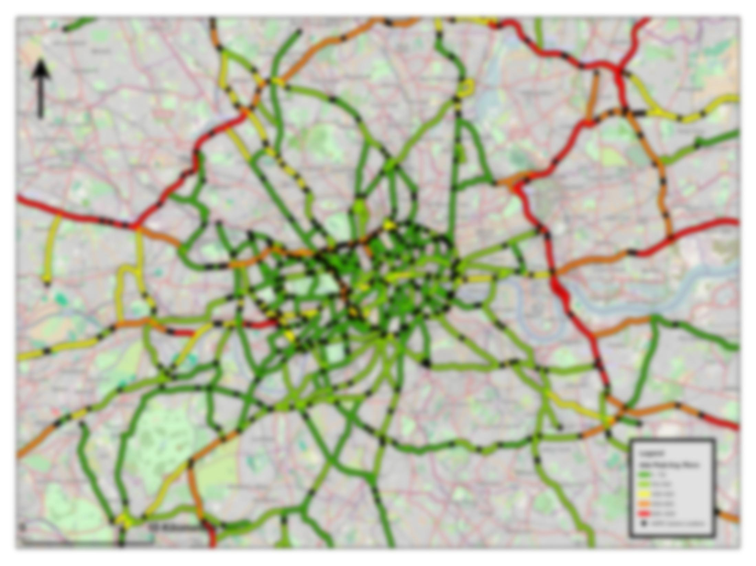
Spatio-temporal modelling of network data
James Haworth
Department of Civil, Environmental and Geomatic Engineering
j.haworth@ucl.ac.uk

Slide 2
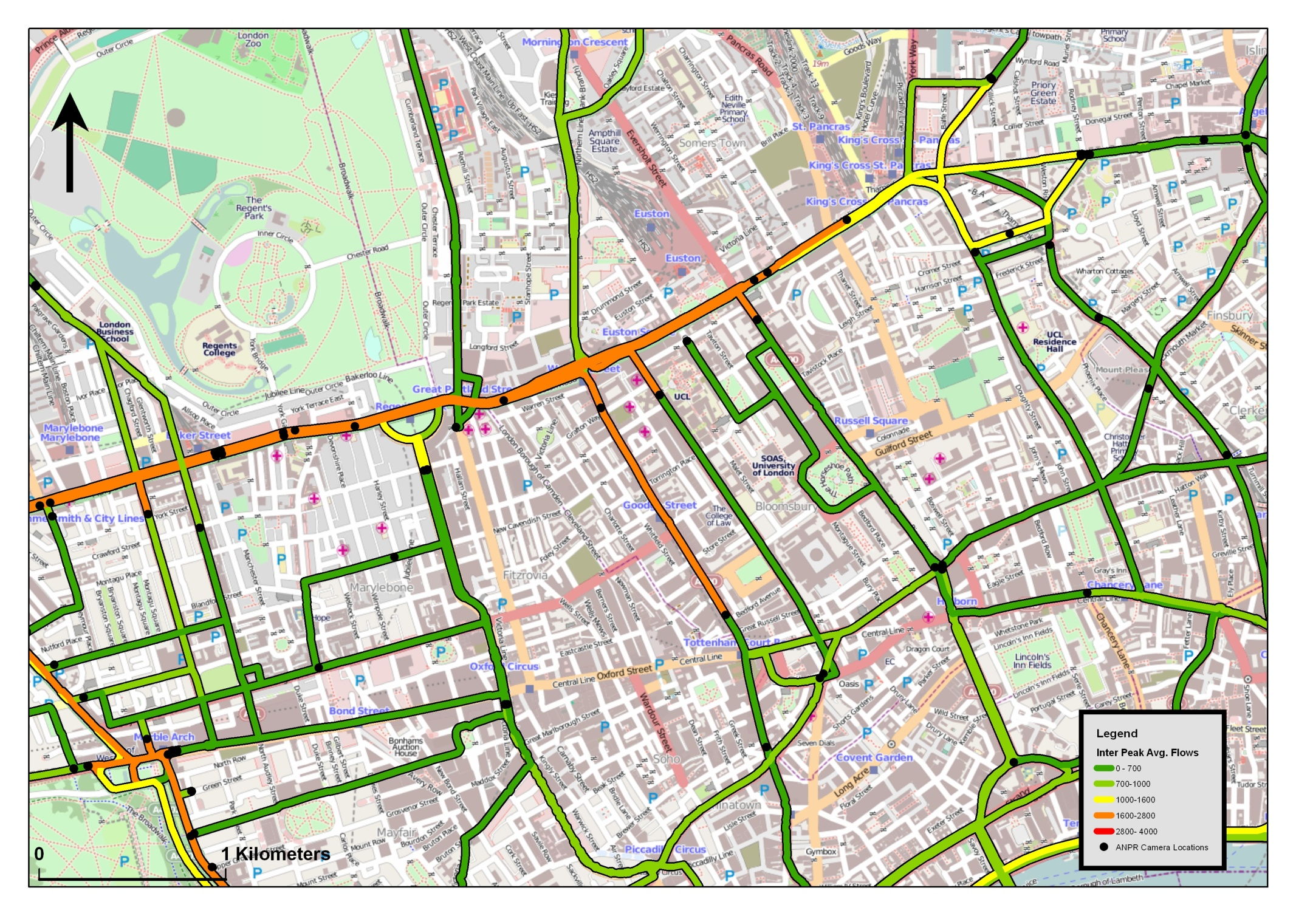
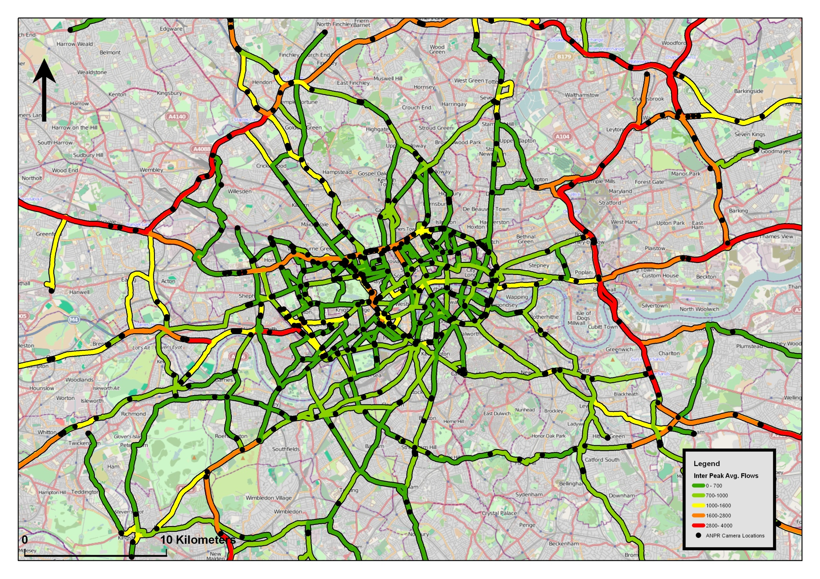
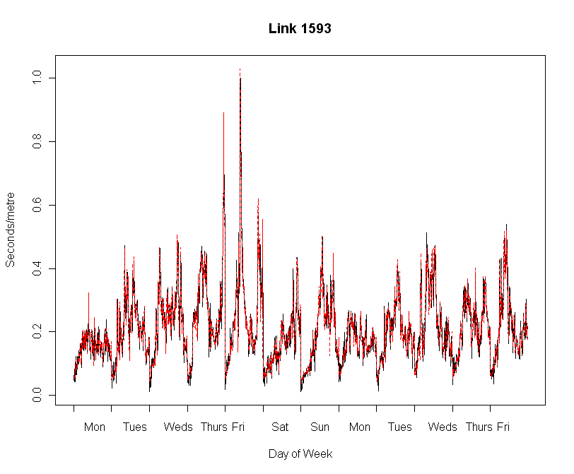
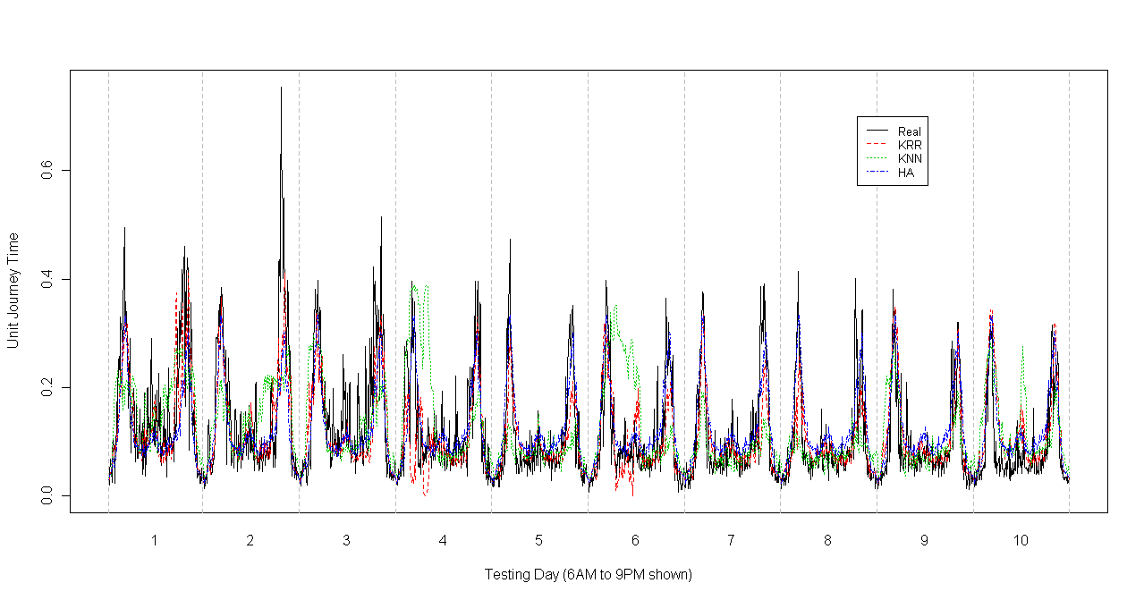

What information do we need to forecast future travel times on Gower Street?
Temporal information
Spatial information
Other forms of adjacency
  Build adjacency from underlying network.
  Use distance based adjacency.
  4. Other sources of information
  Incident data?
  SCOOT flow data
  Social media data.
  @traffic_update
  @londontraffic
Model | Naïve | Hist. Avg | ARIMA | STARIMA | STANN | KRR
Avg. R² | 0.34 | 0.19 | 0.43 | 0.40 | 0.42 | 0.64
Real
KRR
Network adjacency based forecasting:
Network structure is modelled in a spatial weight matrix.
ONLY SPATIAL information is used in this example.
Generally good but:
Can’t predict sudden changes.
Can’t deal well with missing data
The Network is not complete:
Some events have spatio-temporal effect, some don’t…

Slide 3
Thank you for listening
James Haworth
Department of Civil, Environmental and Geomatic Engineering
j.haworth@ucl.ac.uk

