Slide 1

Department of Civil, Environmental and Geomatic Engineering
University College London
Public Perceptions of Crime and Policing
Dr. Ryan Davenport

Slide 2
Overview
‘Signal Crimes and Signal Disorders’
Neighbourhood Effects
A Structural Equation Modelling of British Crime Survey Data
Concluding thoughts...

Slide 3
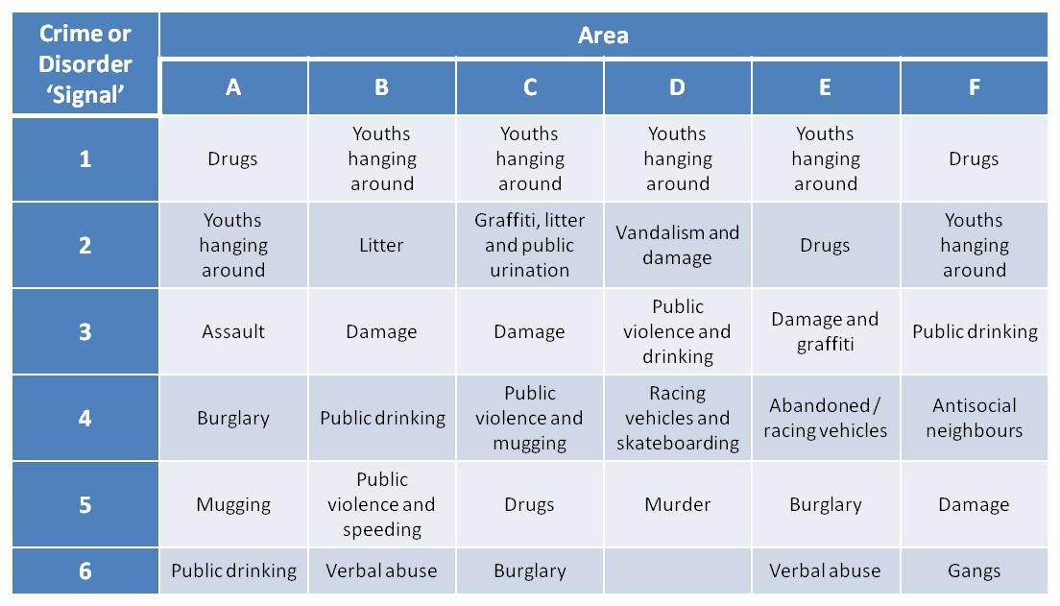
National Reassurance Policing Project: Top ‘crime and disorder signals’ across trial areas
Source: Innes, M. et al. (2004) Signal Crimes and Reassurance Policing (Volume 1), Guildford: University of Surrey.

Slide 4
Perceived disorder and its consequences
“The concept of neighbourhood disorder once again has assumed priority in the social sciences”
(Sampson & Raudenbush 2004:314).
“...the grounds on which perceptions of disorder are formed are contextually shaped by social conditions that go well beyond the usual signs of observed disorder and poverty, starting a process that moulds reputations, reinforces stigma, and influences the future trajectory of an area.
(Sampson, 2012:123)

Slide 5
Structural Equation Modelling of British Crime Survey Data: The Importance of Perceived Disorder
.08
other
other
.00
other
.04
.13
-.01
Personal
Quality of Life
Victimization
-.07
affected by
.07
.09
Fear of Crime
.19
other
.05
.28
.01
.00
-.06
Property
Collective
Victimization
Efficacy
.09
other
.39
-.04
Quality of Life
affected by
-.26
.07
.21
Incivilities
Experience of
.46
Incivilities
-.14
.42
Perceived Problems
with
.60
Incivilities
other
Source: Davenport, R. (2010) Incivilities, Crime and Social Order: The Role of Repeat Experience. Unpublished Ph.D. Thesis: University of Sheffield.
other

Slide 6
Concluding thoughts...
Incivilities can no longer be denied a central role within criminology
Perceptions (of disorder), even if inaccurate can have a significant impact on local social order
Perceived disorder influences individual and corporate decisions which in turn shape the long-term trajectories of neighbourhoods.
Notes:
2# over and above actual experience of incivilities and the extent of criminal victimization.

Slide 7
Department of Civil, Environmental and Geomatic Engineering
University College London
Public Perceptions of Crime and Policing
Dr. Ryan Davenport
Thank you

