Slide 1

Temporal analysis of aoristic crime
Matt Ashby
UCL Security Science Doctoral
Research Training Centre

Slide 2
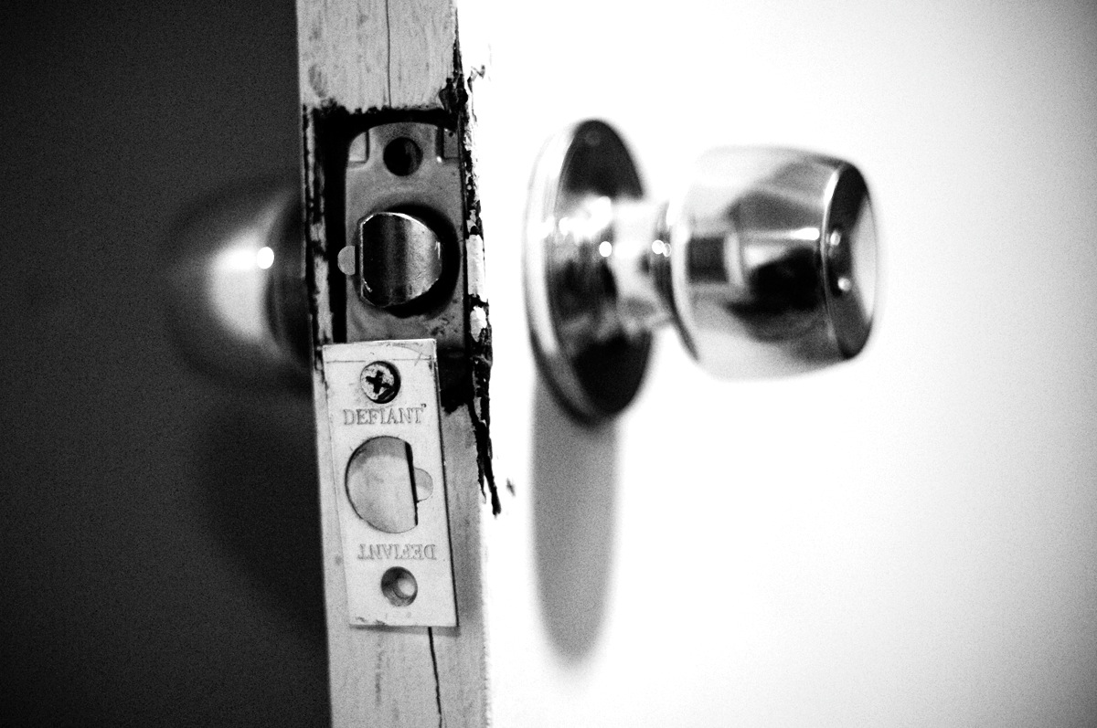
The problem of aoristic crime
If you get home to find your house has been burgled, will you be able to tell the police when it happened?

Slide 3
The problem of aoristic crime
Earliest possible
offence time
Latest possible
offence time
0900 hours
1200
1800
10 hours

Slide 4

Data
Records of 1,396 pedal cycle thefts from railway stations, including offence start and end times and a description of the investigation.

Slide 5
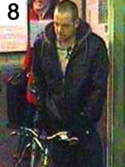
Actual offence
time from CCTV
(303 crimes)
Earliest possible
offence time
Latest possible
offence time
0900 hours
1200
1800

Slide 6


