Slide 1
Linking real and virtual world identities
Muhammad Adnan

Slide 2
Identities of individuals in the real world
Name (Forename & Surname)
Socio-economic characteristics of the geographical areas
Most of us also have virtual identities
Email address; social media accounts
Harvesting these data has interesting potential applications
Cyber crime
Cyber marketing

Slide 3
CACI Email Data
Total number of records:1,154,116 (2002 - 2008)
Data fields are
Title, Forename, Surname, Address, Postcode, Email
1,920 records have no name
183,000 records have no postcode

Slide 4
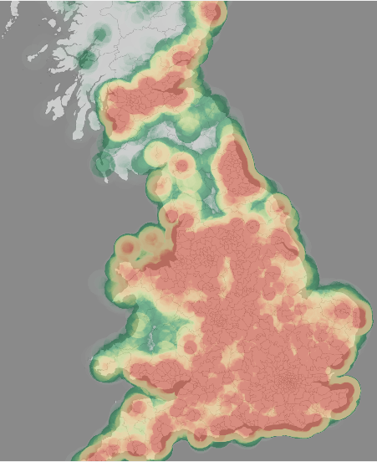
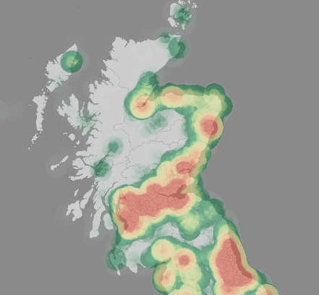
Email data coverage

Slide 5
%age of the email data in each Output Area

Slide 6
Most frequent email domains
hotmail.com | 236067
hotmail.co.uk | 168894
yahoo.co.uk | 122136
aol.com | 96743
btinternet.com | 70213
yahoo.com | 53410
ntlworld.com | 47766
gmail.com | 30657
live.co.uk | 25133
googlemail.com | 23720
msn.com | 23367
blueyonder.co.uk | 19486
tiscali.co.uk | 19046
sky.com | 18777
talktalk.net | 16970

Slide 7
What % of the people use their identity as part of their email address
546,111 (47%) records had surname as part of the email address
anna_culliford@hotmail.com (Surname: culliford)
307,496 (26%) records had both forename and surname as part of the email address
john.bradshaw100@ntlworld.com
(Surname: bradshaw ; Forename: john)

Slide 8
Who use long email addresses ?
Hispanice, Portugese, and Indians have long email addresses (Average length: 13 characters)
South Indians have longer email address than North Indians
ANA.ARAUJO3909@HOTMAIL>COM (14 characters)
BYRON.DELGADO.INOSTROZA@HOTMAIL.COM (25 characters)
DIEGOJAVIERZEBALLOS@GMAIL.COM (17 characters)
GANGULYDEEPANJAN@HOTMAIL.COM (18 characters)
AGUSTINAREYNOZO@GMAIL.COM (13 characters)

Slide 9
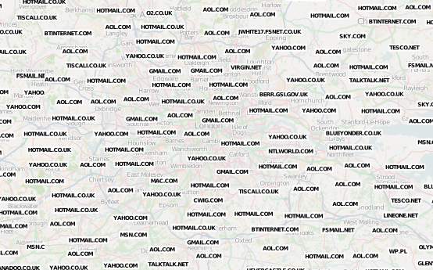
Top email domain for each Output Area

Slide 10
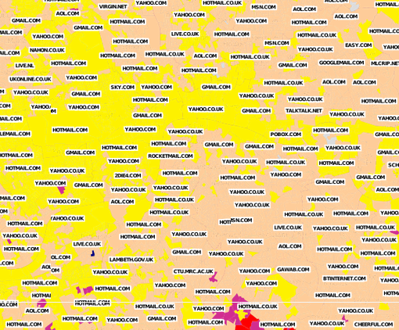
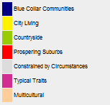
Top email domains against (OAC, 2001)

Slide 11
Thanks for Listening

